Slide 1

Ducky Run
By: Manreet Kaur, Joe Andro, Edmund Agyekum

Slide 2
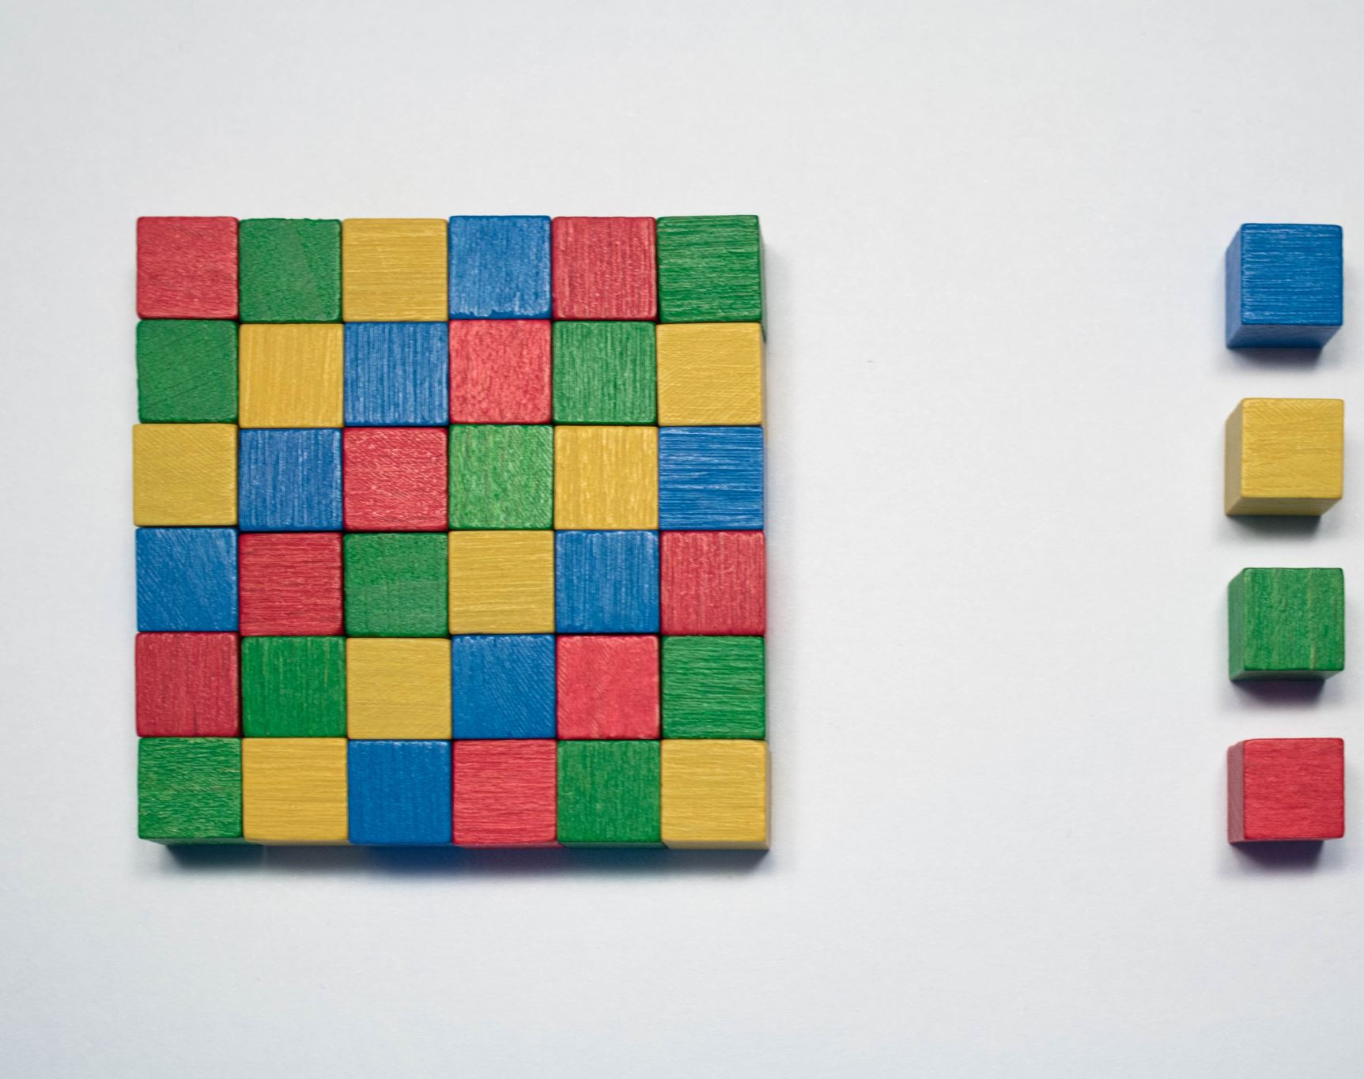
What is our game?
The purpose of the game is that there is a Duck which is the main character and the goal for it is to hit each box. As it hits each box or rectangle the score increases and once the duck hits all of the boxes the game ends. Each box is set to have different points based on its color.
Notes:
Joe

Slide 3
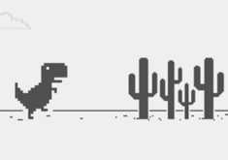
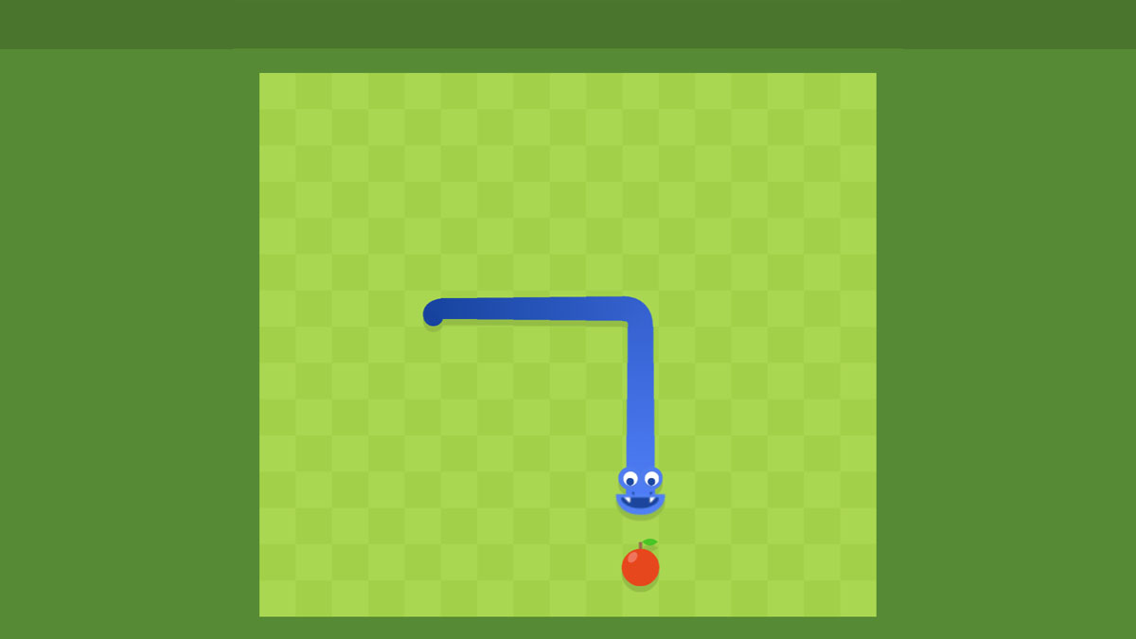
Brainstorm/Ideas
Snake Game
Dinosaur Game
Notes:
Joe

Slide 4

Steps to create game
Start with the Duck figure.
Get the overall map with the boxes used in the game which was created on a separate c file.
Duck moves up, down, right, and left.
Add the score displayed on the screen.
Add a game over screen.
Notes:
Manreet

Slide 5
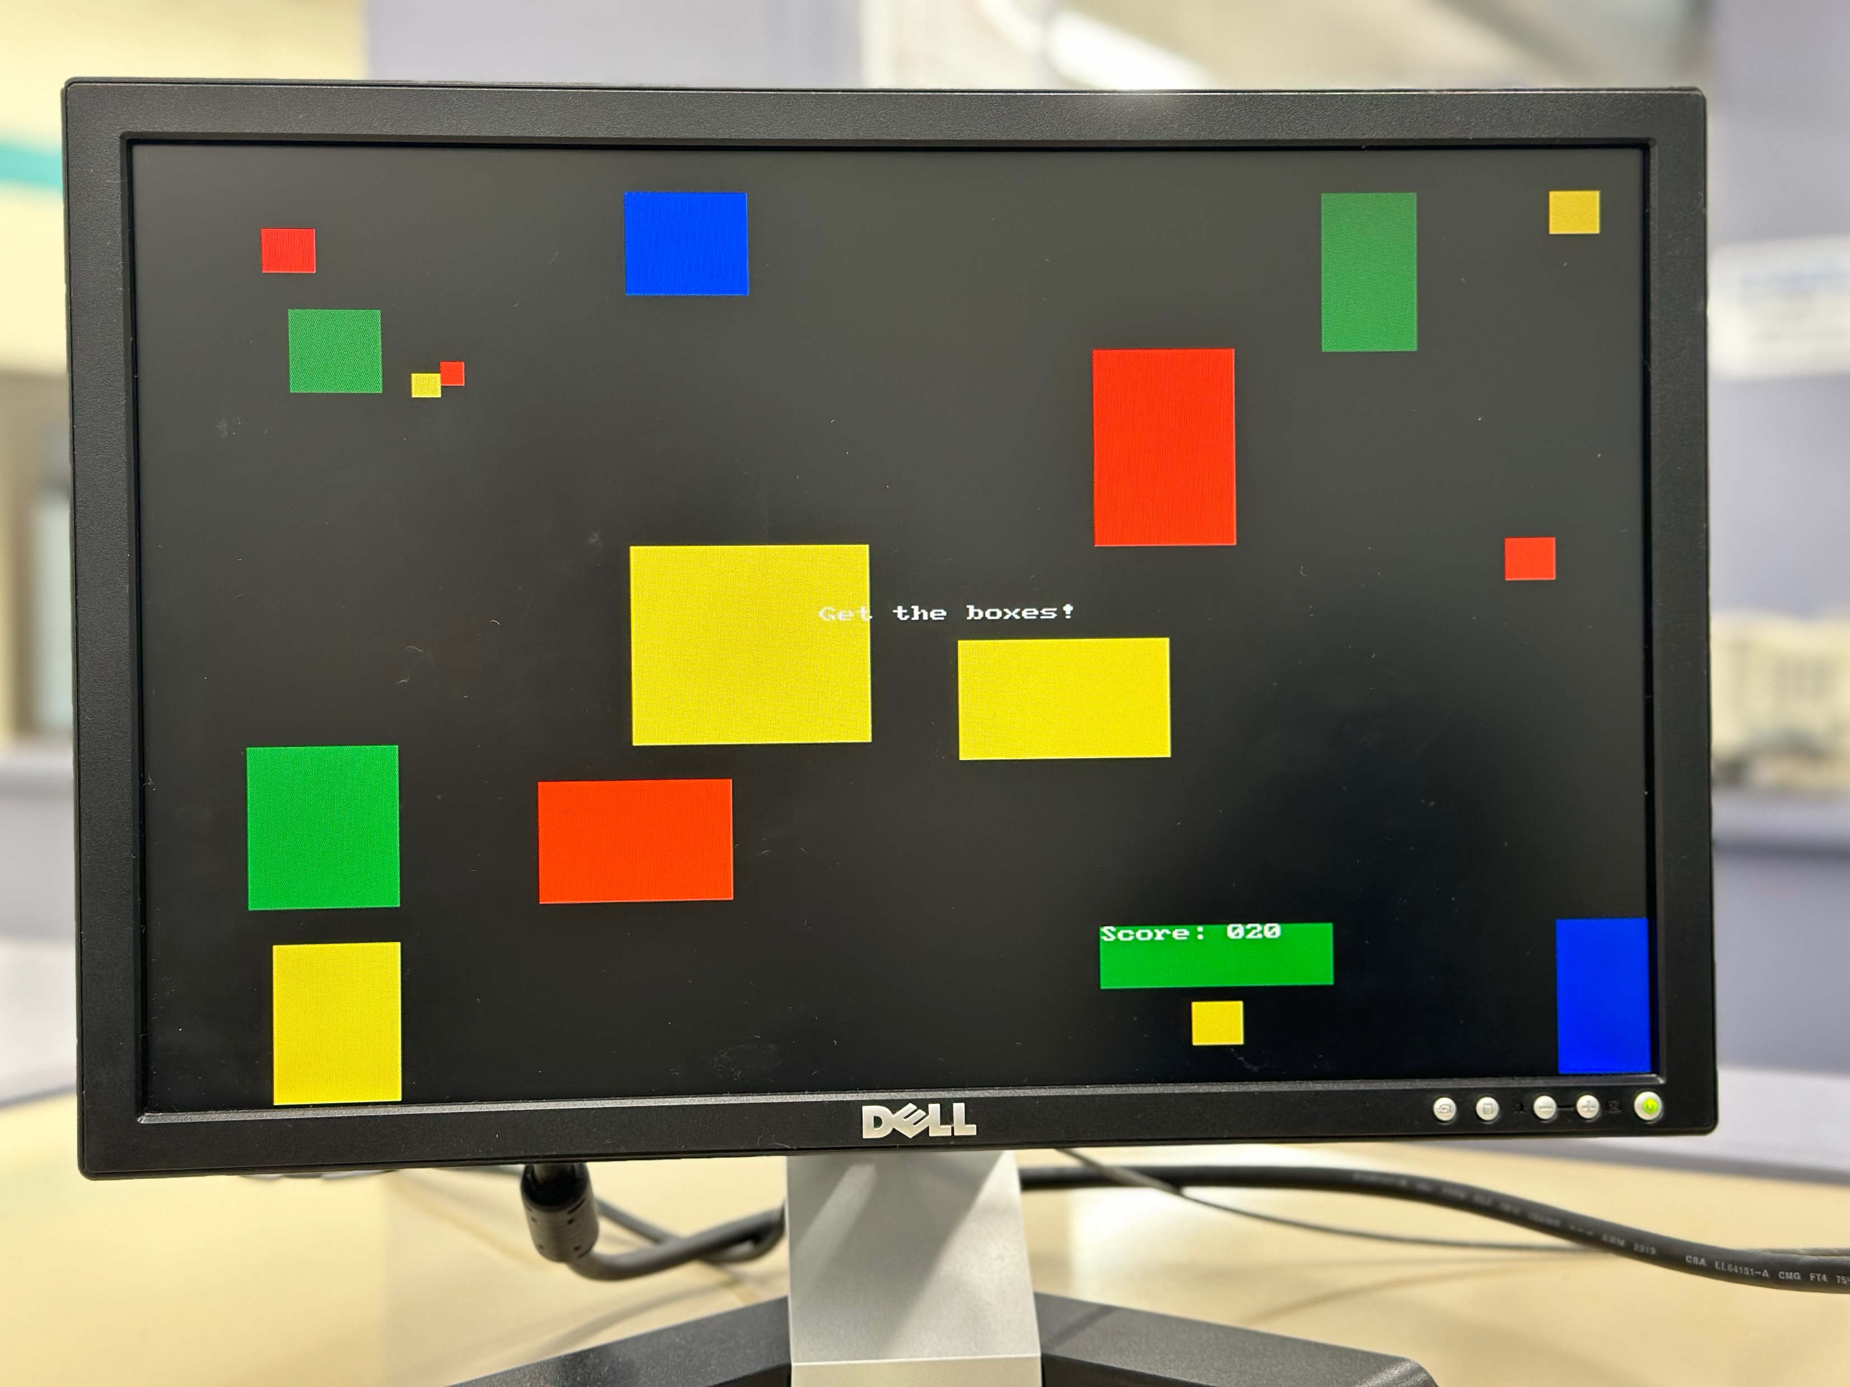
How the game works?
The objective of the game is for the player to use the ‘a’, ‘s’, ‘d’, and ‘w’, key to move the duck and to hit each box on the screen. As the duck hits the screen the score adds up. The max score the user can get is 420. Once the score reaches 420 then then you win. If you leave the bounds of the game, then the game is over.
Blue = 50 points
Green = 30 points
Red = 20 points
Yellow = 10 points
Notes:
Edmund

Slide 6
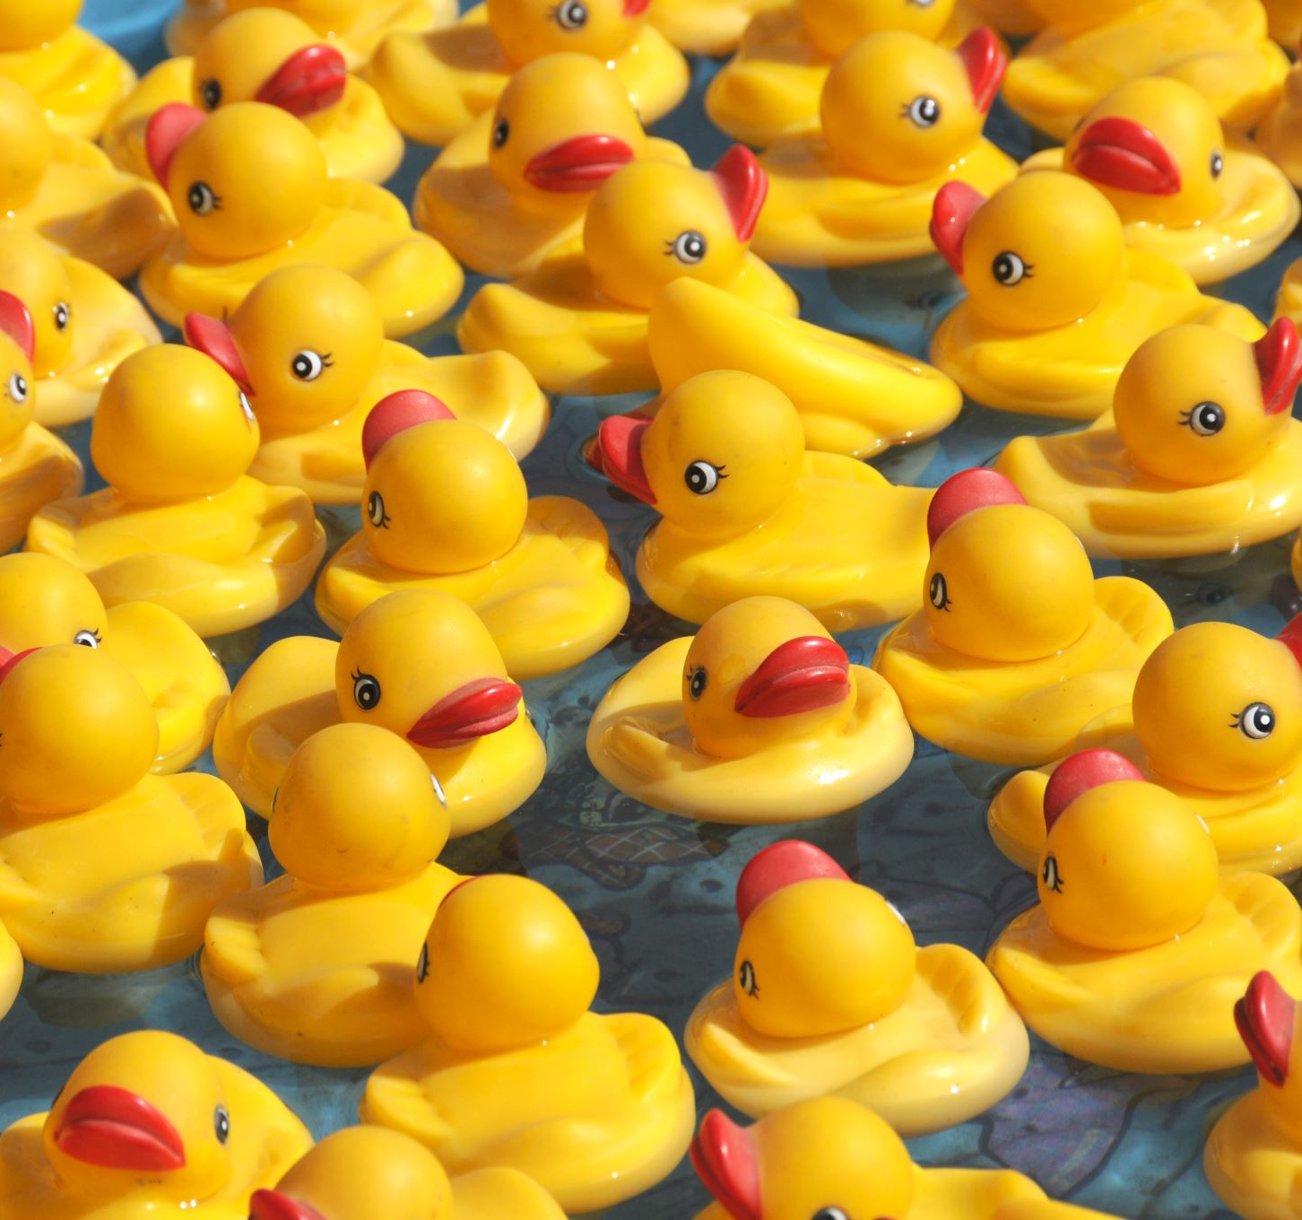
Pseudocode
Create the initial duck
Repeating while loop:
Create the text value for the total score
If the score is less that the highest achievable score:
Move the duck
Create the map based on the duck's location
Grab any boxes that are in the duck’s location
Show related score on the screen
If the score is equal to the highest achievable score (all boxes have been grabbed):
Updated the onscreen score
Create a “you win” screen
If you leave the bounds of the game:
Create a “you lose screen”
Notes:
Edmund

Slide 7
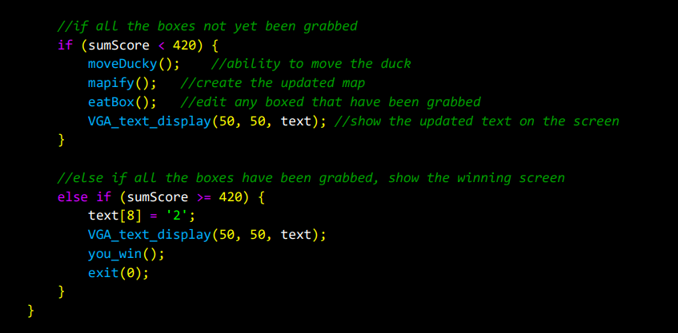
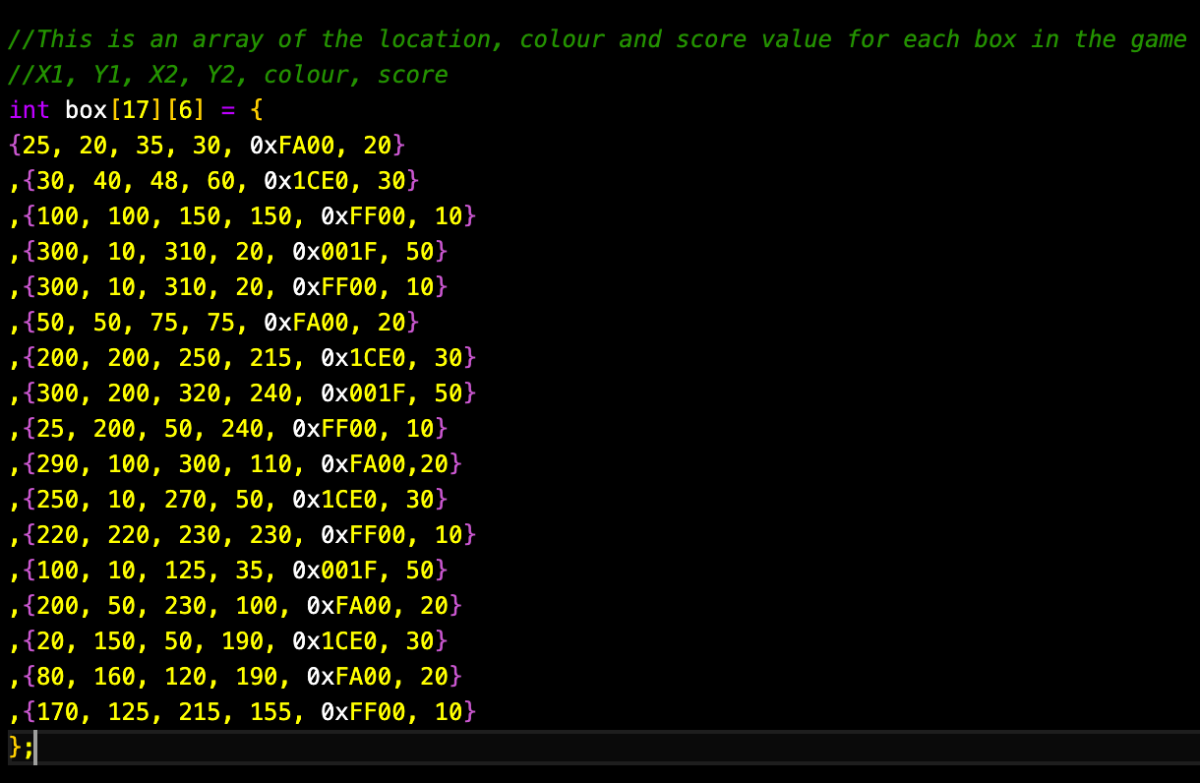
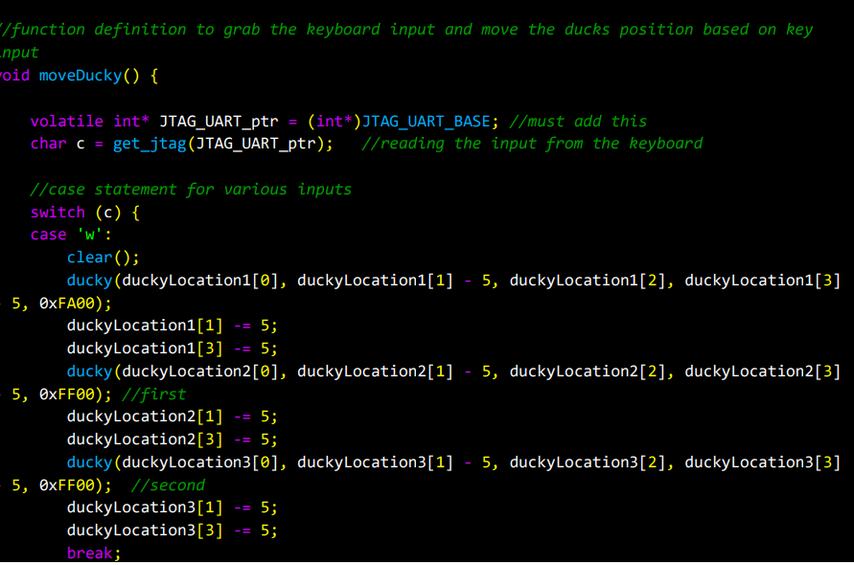
Code
Conditional statements for the score in the main.
Initial map array
Function Definition: to move the duck using keyboard inputs.
Notes:
Edmund

Slide 8
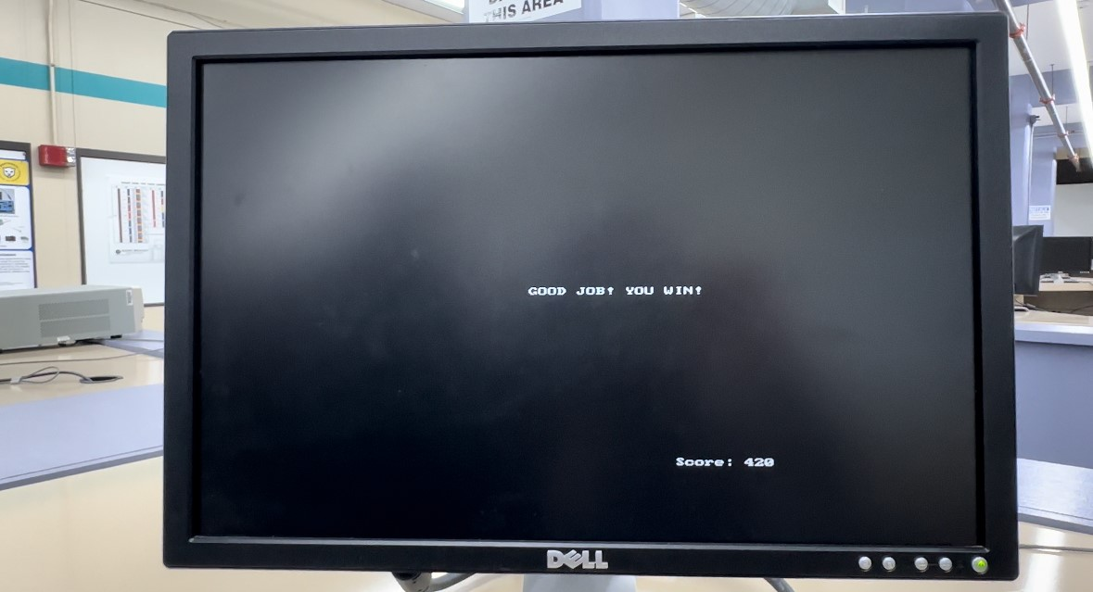
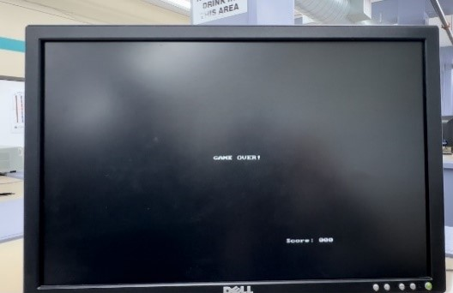
Screenshots
Start Screen
You Win
Game Over
Notes:
Manreet

Slide 9
Video
Final Project Video.mov

Slide 10


Difficulties/Challenges
Controlling the character using 'ASWD'.
Various syntax and pointer errors when trying to manipulate arrays and text on the screen.
Removing the box from the map. We decided to just hide the boxes instead.
Boxes could not be grabbed if the duck left the screen and came back so we made it an out of bounds zone.
Notes:
Joe

Slide 11
New skills learned
How to use the monitor program and how to program for microcontrollers
Animation using C, monitors, and DE-10 boards
How to access separate files in our main program
How to create, access and edit arrays
Notes:
Manreet

Slide 12
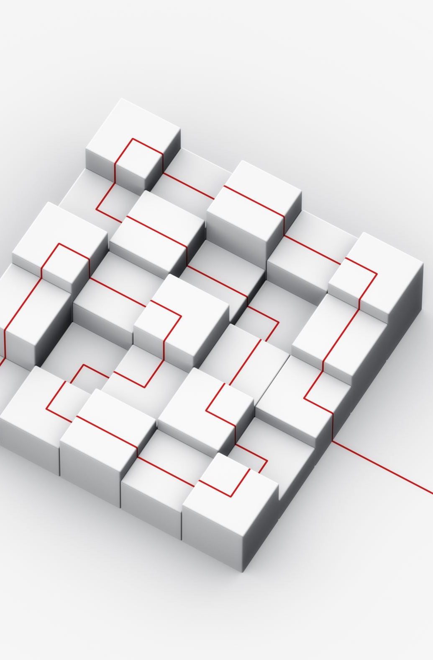
Improvements
Add a random function to randomize the boxes on the screen
Display score on the DE-10 board as well
Add some creative mapping to make it more challenging like walls that cannot be touched.
Notes:
Manreet

Slide 13

Questions?

